Slide 1
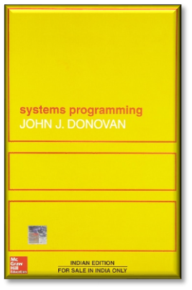
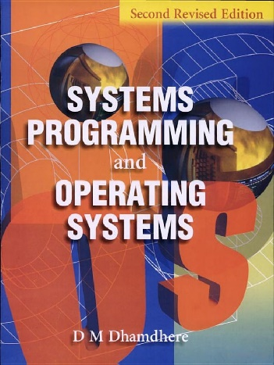
System Programing and Operating System
Unit-I
Text Book:
  John Donovan, “System Programming”, McGraw Hill.
  Dhamdhere D., "Systems Programming and Operating Systems", McGraw Hill
UNIT-I OF SYSTEM PROGRAMMING AND OPERATING SYSTEM

Slide 2
Contents
Introduction to System Programming
Need of systems programming
Software
Software Hierarchy
Types of software: System s/w and Application s/w
Evolution of Components of System Software/Programs:
  Text editors
  Loaders
  Assemblers
  Macro processors
  Compilers
  Debuggers
UNIT-I OF SYSTEM PROGRAMMING AND OPERATING SYSTEM

Slide 3
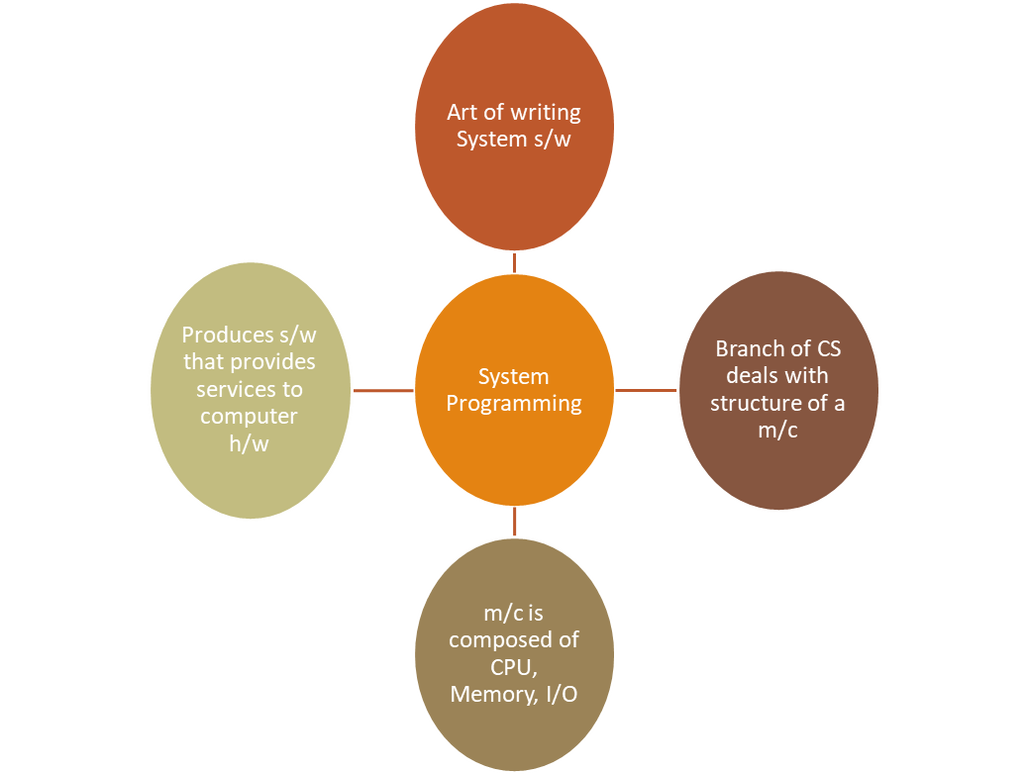
What is System Programming?
UNIT-I OF SYSTEM PROGRAMMING AND OPERATING SYSTEM
Notes:
Art of writing system software
Is a branch of computer science that deals with the structure of a machine.
The structure of a machine may compose of memory, I/O, CPU, etc.
Systems programming aims to produce software which provides services to the computer hardware

Slide 4
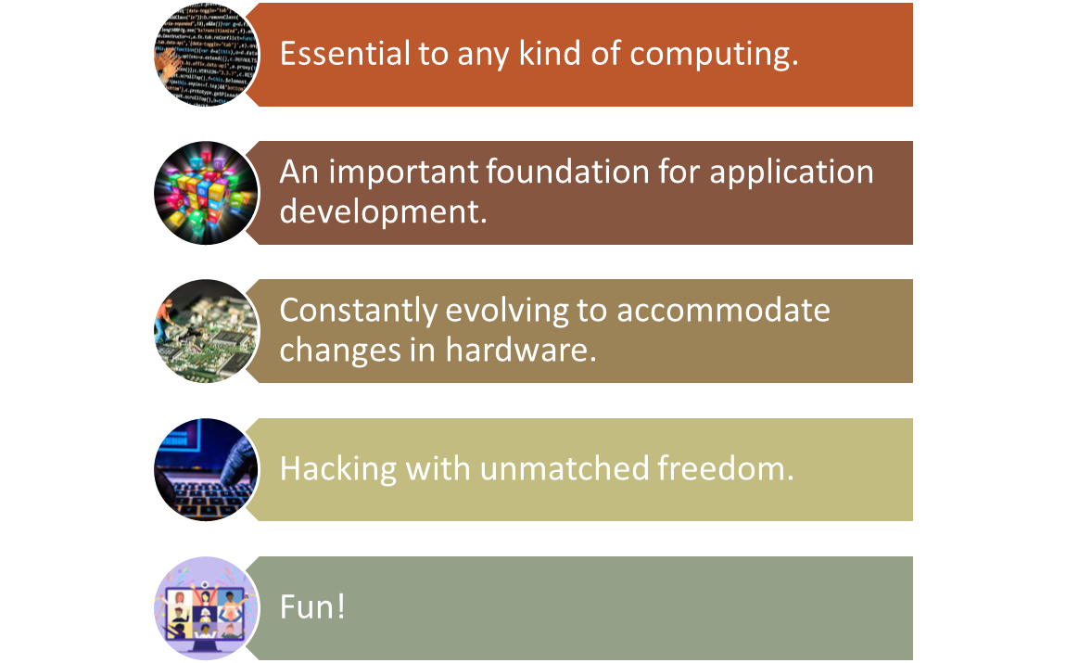
Why System Programming?
UNIT-I OF SYSTEM PROGRAMMING AND OPERATING SYSTEM

Slide 5

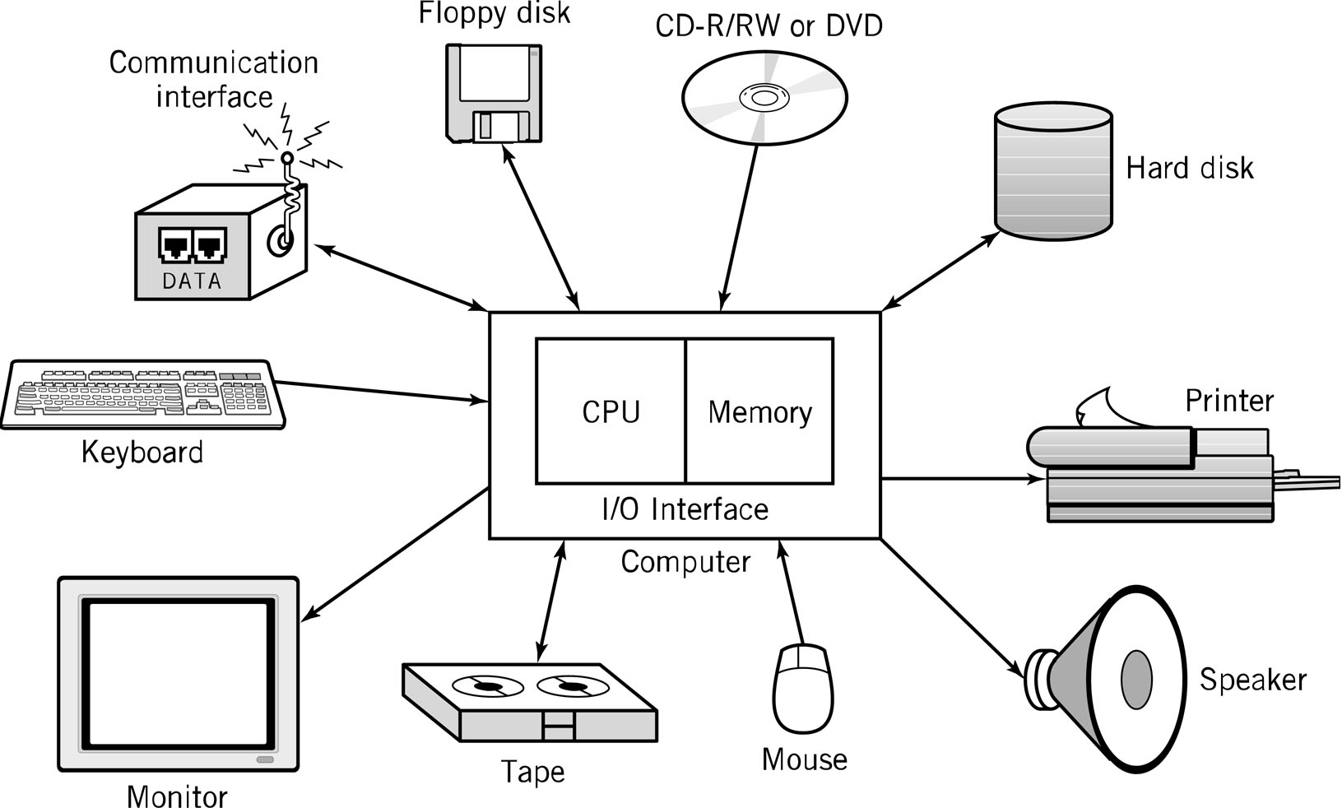
Typical Personal Computer System
UNIT-I OF SYSTEM PROGRAMMING AND OPERATING SYSTEM
1-<number>

Slide 6

Software
Computer hardware is useless without software.
Software is a set of instructions, data or programs used to operate computers and execute specific tasks.
UNIT-I OF SYSTEM PROGRAMMING AND OPERATING SYSTEM

Slide 7
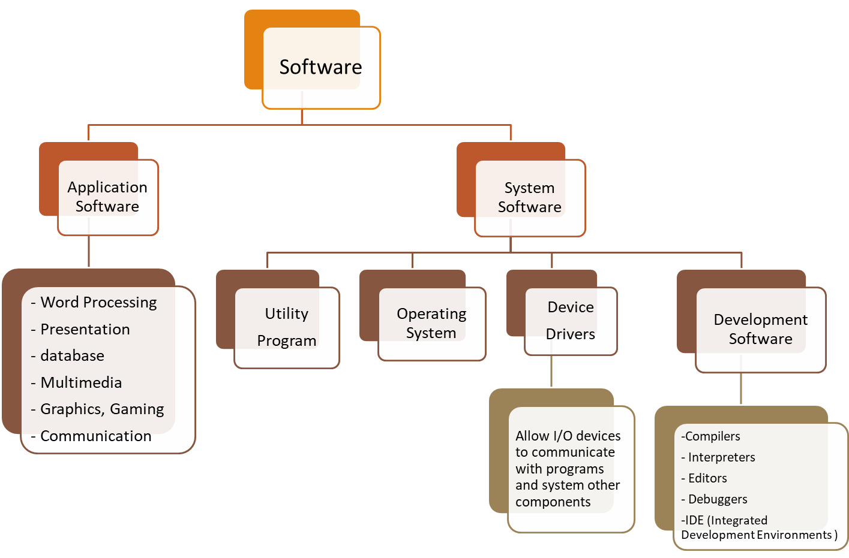
Software Hierarchy
UNIT-I OF SYSTEM PROGRAMMING AND OPERATING SYSTEM

Slide 8
The major types of software
Application software
System software
System Software
Operating Systems
Schedules computer events, Allocates computer resources, Monitor events
Hardware
Users
Language translators
-Interpreters
-Compilers
Application Software
Programming languages like Assembly language, FORTRAN, BASIC, PL/1, PASCAL, C, “4th generation” languages, Airway reservation system, banking system, etc.
Utility programs
Routine operations
  (e.g. sort, list, print)
Manage data
  (e.g. create files, merge files)
UNIT-I OF SYSTEM PROGRAMMING AND OPERATING SYSTEM

Slide 9





System Programming and its components
UNIT-I OF SYSTEM PROGRAMMING AND OPERATING SYSTEM

Slide 10

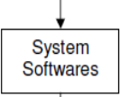
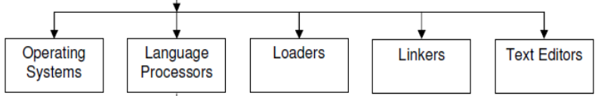
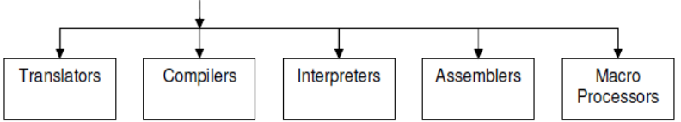
Components of computer system programming
UNIT-I OF SYSTEM PROGRAMMING AND OPERATING SYSTEM

Slide 11
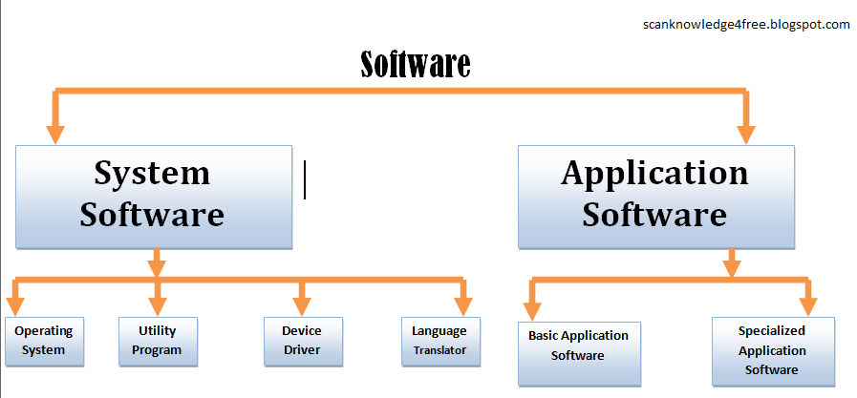

Types of Software's
System software helps the computer to carry out its basic operating tasks
Application software helps the user carry out a variety of tasks
UNIT-I OF SYSTEM PROGRAMMING AND OPERATING SYSTEM

Slide 12
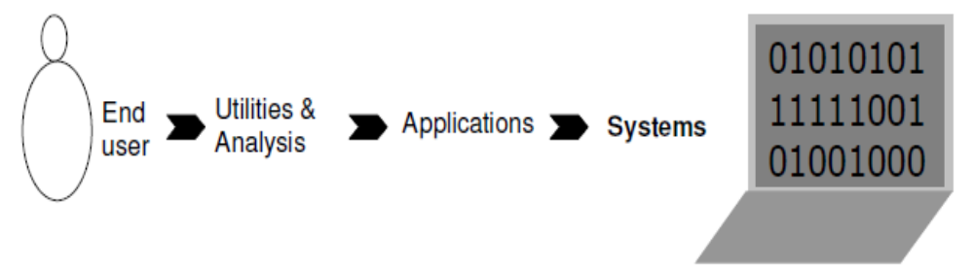
Introduction(cont..)
Main goal of system software’s (system Programs) is to reduce the communication gap between humans and computers.
UNIT-I OF SYSTEM PROGRAMMING AND OPERATING SYSTEM

Slide 13
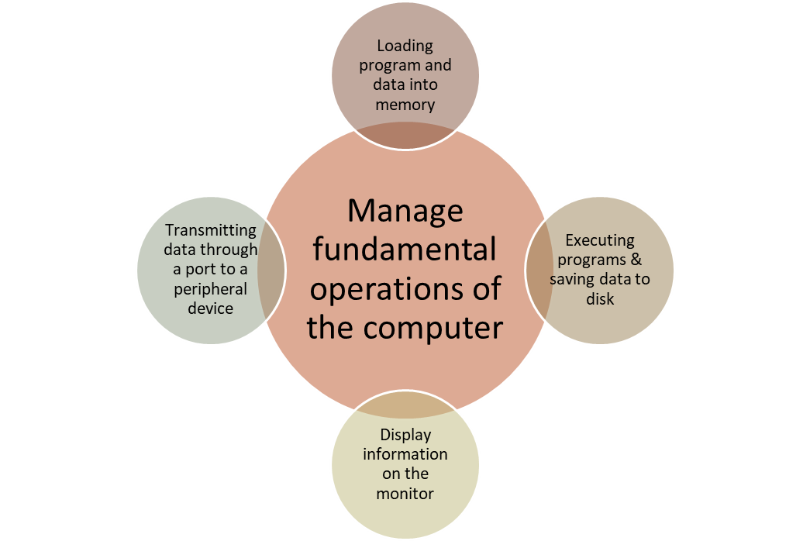
Roles of System Software
Examples:
operating systems, utilities, editors, loader, linkers, device drivers
UNIT-I OF SYSTEM PROGRAMMING AND OPERATING SYSTEM

Slide 14
Text Editors
They allow the user to enter the program in text, prepare documents, etc.
Tasks of editor
  Facilitate programmer to enter and save code
  Allow to modify the code, if needed
Examples:
  Note / Word pad, vi, gedit and many more
UNIT-I OF SYSTEM PROGRAMMING AND OPERATING SYSTEM

Slide 15
Language Translators
梅雨が好き
Tsuyu ga suki
ನನಗೆ ಮಳೆಗಾಲ ಇಷ್ಟ
મને વરસાદની મોસમ ગમે છે
I like rainy season
मला पावसाळा आवडतो
UNIT-I OF SYSTEM PROGRAMMING AND OPERATING SYSTEM

Slide 16
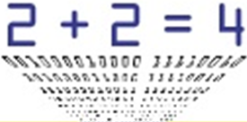
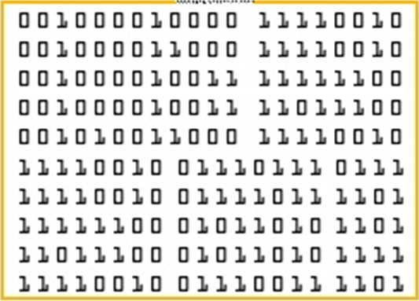
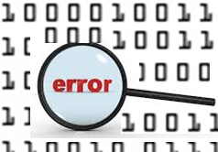
Exercise
UNIT-II BY D N PATIL, COMPUTER DEPARTMENT, SCOE,PUNE

Slide 17

Compiler
Software that translates a high-level language program into machine language
Input to the compiler is a source file (created by word processor or editor) containing the text of a high-level language program
If it is syntactically correct, compiler will save in an object file which is a machine language instructions for the same job
Compiler
TARGET PROGRAM
( Normally the equivalent program in machine code – relocatable object file)
SOURCE PROGRAM
( Normally a program written in a high-level programming language)
Error Messages
UNIT-I OF SYSTEM PROGRAMMING AND OPERATING SYSTEM

Slide 18
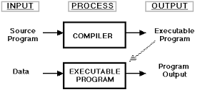
Compiler (cont..)
UNIT-I OF SYSTEM PROGRAMMING AND OPERATING SYSTEM

Slide 19
Quick Revision
Software
Types of software
Components of System software
  Text editor
  Language Translator
    Compiler
UNIT-I OF SYSTEM PROGRAMMING AND OPERATING SYSTEM

Slide 20
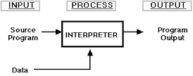
Interpreter
a program that can analyze and execute a program line by line.
An interpreter is a system software (computer program) that directly executes instructions written in a programming or scripting language, without previously compiling them into a machine language program.
UNIT-I OF SYSTEM PROGRAMMING AND OPERATING SYSTEM

Slide 21
Assembler
An assembler is a type of computer program that translates programs written in assembly language into machine language, code and instructions that can be executed by a computer.
Assembly language
Program (input)
Assembler
machine language
Program (output)
UNIT-I OF SYSTEM PROGRAMMING AND OPERATING SYSTEM

Slide 22
Quick recap of last session
-Need of SP
-Components of Sys. S/w
-Compiler
-Interpreter
- Assembler
UNIT-I OF SYSTEM PROGRAMMING AND OPERATING SYSTEM

Slide 23
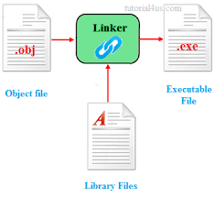
Linker
All machine instructions are not complete
High-level language programs use at least one of the function that reside in other object files available to the system
Linker combines several object files, resolving cross references between the files, into one executable file (machine language program)
UNIT-I OF SYSTEM PROGRAMMING AND OPERATING SYSTEM

Slide 24
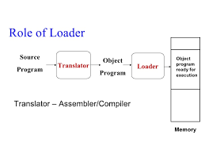
Loader
To run an executable file, the loader must copy all the instructions into memory and direct the CPU to begin execution with the first instruction
As the program executes, it takes input data from source(s) and sends results to output devices
UNIT-I OF SYSTEM PROGRAMMING AND OPERATING SYSTEM

Slide 25
Macro Processor
  A macro instruction is a notational convenience for the programmer
  It allows the programmer to write shorthand version of a program (module programming)
  The macro processor replaces each macro invocation with the corresponding sequence of statements (expanding)
UNIT-I OF SYSTEM PROGRAMMING AND OPERATING SYSTEM

Slide 26
Macro Processor
Recognize macro definitions
Save the macro definition
Recognize macro calls
Expand macro calls
Source Code
(with macro)
obj
Macro Processor
Expanded Code
Compiler or Assembler
UNIT-I OF SYSTEM PROGRAMMING AND OPERATING SYSTEM

Slide 27
Debugger
It is a tool to facilitate programmer to remove logical programming errors
Features
  Execute program in various modes
    Complete, breakpoint, single stepping
  Display contents of the microprocessor and memory
    All the CPU registers, memory locations in use
  Present status of the execution
    Present status of flags (psw), location of next instruction (pc)
UNIT-I OF SYSTEM PROGRAMMING AND OPERATING SYSTEM

Slide 28

Application software
These are set of programs written to perform specific tasks
such as
  word processing ( MS Word/ WordPerfect),
  accounting (Lotus 1-2-3/ Excel),
  database management (Access/ dBASE)
  Games with graphics effects
UNIT-I OF SYSTEM PROGRAMMING AND OPERATING SYSTEM

Slide 29
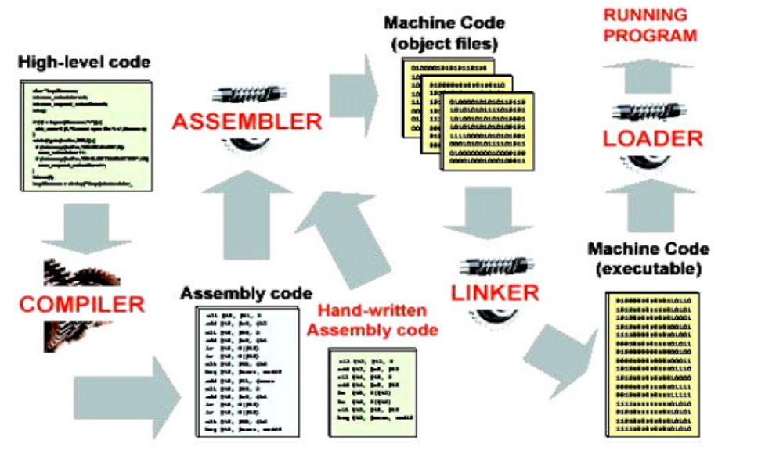
The structure explaining steps between the HLL to executable program and role of System Programming in its working sequence.
UNIT-I OF SYSTEM PROGRAMMING AND OPERATING SYSTEM

Slide 30
Questions
Q. 1. What is System software? Explain following system software's with suitable diagrams.
1. Compiler 2. Assembler 3. Debugger 4. Text Editors 5. Loader
6. Linker 7. Macro Processor
Q. 2. Define following:
1. Compiler 2. Assembler 3. Debugger 4. Text Editors 5. Loader
6. Linker 7. Macro Processor
Q.3. Explain need of system softwares?
UNIT-I OF SYSTEM PROGRAMMING AND OPERATING SYSTEM

Slide 31

UNIT-I OF SYSTEM PROGRAMMING AND OPERATING SYSTEM

Slide 32
Language Translators
お元気ですか？
Ogenkidesuka?
ನೀವು ಹೇಗಿದ್ದೀರಿ?
તમે કેમ છો?
how are you?
UNIT-I OF SYSTEM PROGRAMMING AND OPERATING SYSTEM

